Slide 1

COMP 90049
Knowledge Technologies
Week 11
我们毕业啦
其实是答辩的标题地方
Tutor
Ang Li

Slide 2
Name: Ang Li
E-mail: angl4@student.unimelb.edu.au
Contact information
Research topic: computer vision

Slide 3
Summery
Work through this week’s exercise
Notes:
Secure File Transfer Protocol
Secure Shell

Slide 4
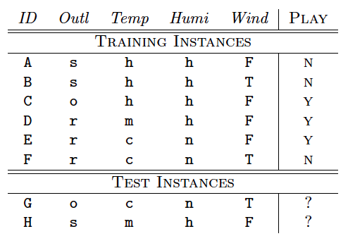
Exercise 1.
Classify the test instances using a Decision Tree:
a) Using the Information Gain as a splitting criterion

Slide 5


a) For Information Gain, at each level of the decision tree, we're going to choose the attribute that has the largest difference between the entropy of the class distribution at the parent node, and the average entropy across its daughter nodes.
In this dataset, we have 6 instances total: 3 y and 3 n . The entropy at the top level of our tree is:

Slide 6

This is a very even distribution. We're going to hope that by branching the tree according to an attribute, that will cause the daughters to have an uneven distribution --- which means that we will be able to select a class with more condence --- which means that the entropy will go down.
For example, for the attribute Outl , we have three attribute values: s , o , r .
When Outl =s , there are 2 instances, which are both n . The entropy of this distribution is
When Outl =o , there is a single instance, of class y . The entropy here is going to be 0 as well.
When Outl =r , there are 2 y instances and 1 n instance. The entropy here is

Slide 7
The overall information gain here is
Now please calculate the IG of “Temp”, “Humi”, “Wind”

Slide 8
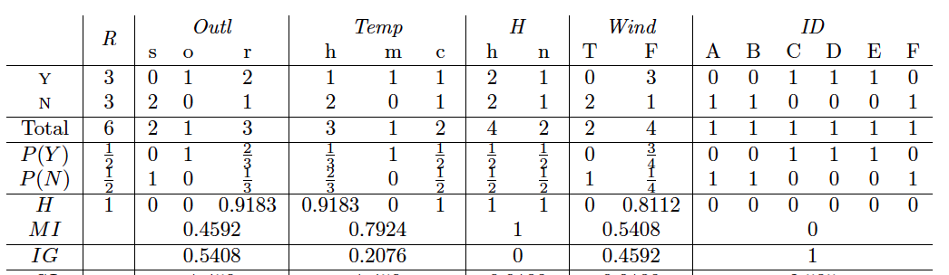
The table lists the Mean Information (MI ) and Information Gain (IG ), for each of the 5 attributes.
At this point, ID has the best information gain, so hypothetically we would use that to split the root node. however, we would be left with a completely useless classier! (Because the IDs of the test instances won't have been observed in the training data.)
Instead, let's take the second best attribute: Outl .

Slide 9

There are now three branches from our root node: for s , for o , and for r . The first two are pure, so we can't improve them any more. Let's examine the third branch (Outl =r ):
Three instances (D, E, and F) have the attribute value r ; we've already calculated the entropy here to be 0.9183.
If we split now according to Temp , we observe that there is a single instance for the value m (of class n , the entropy is clearly 0); there are two instances for the value c , one of class y and one of class n (so the entropy here is 1). The mean information is and the information gain at this point is

Slide 10
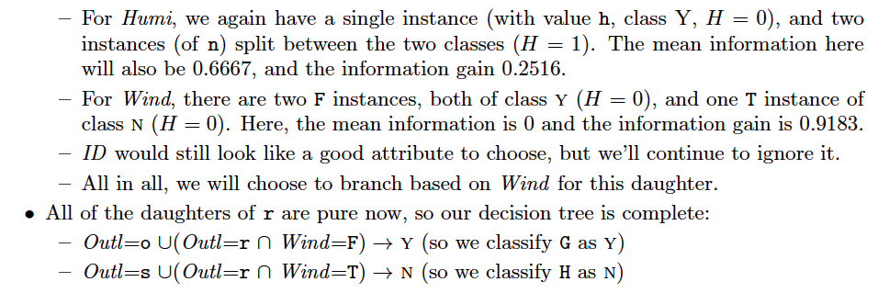

Slide 11
Exercise 2. Review the concepts of Recommendation Systems :
What is Content-based Recommendation?
As you might expect, this describes methods of making recommendation based on the content of items, usually by comparing them to items that the users has seen or enjoyed.
What is Collaborative Filtering?
Collaborative Filtering is a strategy for recommender systems where the recommendations for one user are based on different users' preferences.

Slide 12
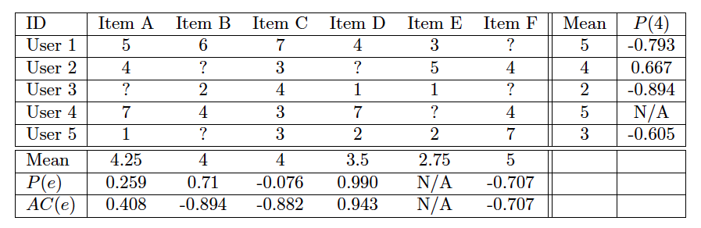
Exercise 3. Consider the following rating table between ve users and six items:
Predict the value of the unknown rating for User 4 using User-based Collaborative Filtering. (i.e. Find the Pearson correlation between users, and adjust User 4's mean score).

Slide 13
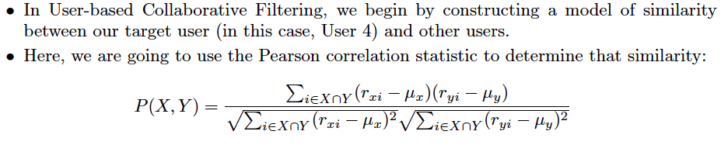
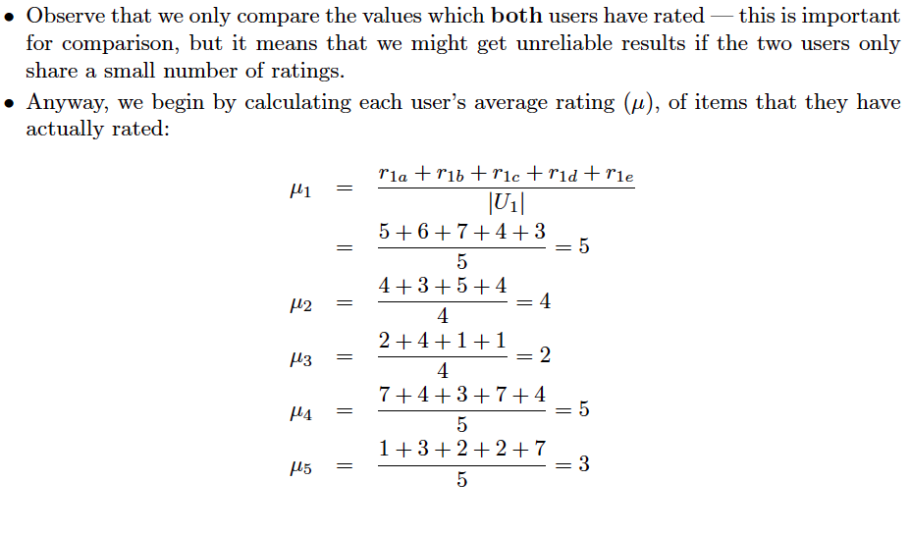

Slide 14
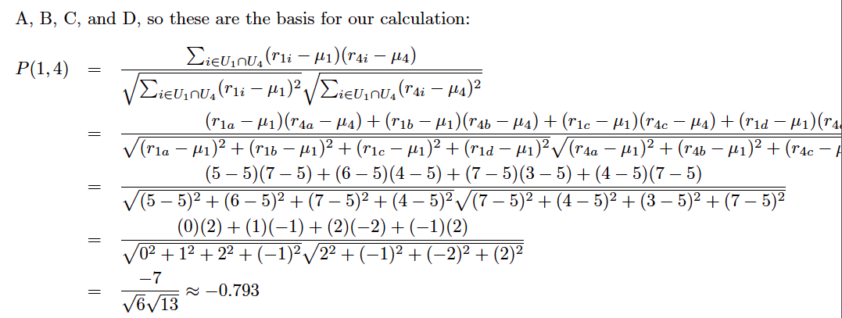

Slide 15
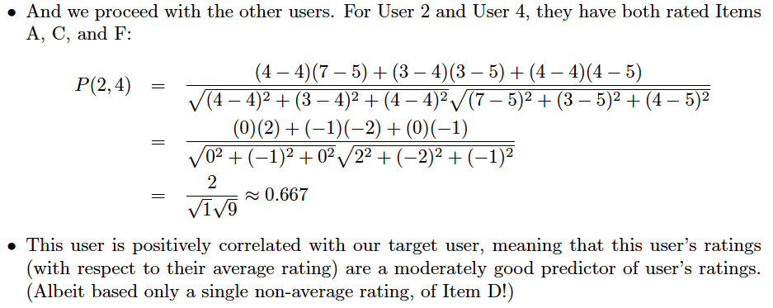

Slide 16
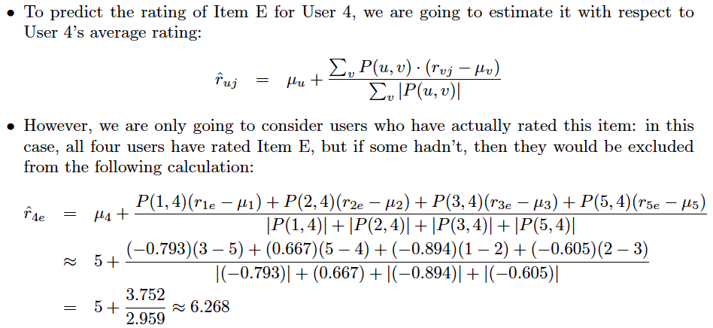

Slide 17
Thanks!

